Slide 1
structures

Slide 2
Introduction
Structures—sometimes referred to as aggregates—are collections of related variables under one name.
Structures may contain variables of many different data types—in contrast to arrays, which contain only elements of the same data type.
Structures are commonly used to define records to be stored in files
Pointers and structures facilitate the formation of more complex data structures such as linked lists, queues, stacks and trees

Slide 3
Structure Definitions
Structures are derived data types—they’re constructed using objects of other types.
Consider the following structure definition:
struct _test {
unsigned int m1 ;
unsigned char m2 ;
unsigned short m3 ;
unsigned char m4;
} ;
Keyword struct introduces the structure definition.
The identifier _test is the structure tag, which names the structure definition and is used with struct to declare variables of the structure type—e.g., struct _test
In this definition, we define just a type of a structure. No variables are declared.

Slide 4
Structure Definitions (Cont.)
Variables declared within the braces of the structure definition are the structure’s members.
Members of the same structure type must have unique names, but two different structure types may contain members of the same name without conflict
Each structure definition must end with a semicolon.

Slide 5
Structure Definitions (Cont.)
The definition of struct _test contains members m1, m2, m3, and m4
Structure members can be variables of the primitive data types (e.g., int, float, etc.), or aggregates, such as arrays and other structures.
Structure members can be of many types.

Slide 6
Self-Referential Structures
A structure cannot contain an instance of itself.
For example, a variable of type struct _test cannot be declared in the definition for struct _test .
A pointer to struct _test, however, may be included.
For example,
struct _test {
unsigned int m1 ;
unsigned char m2 ;
unsigned short m3 ;
unsigned char m4;
struct _test v1; // ERROR
struct _test *p; // self referential structure, OKAY
} ;

Slide 7
Structure Definitions (Cont.)
Because *p is a pointer (to type struct _test ), it’s permitted in the definition.
A structure containing a member that’s a pointer to the same structure type is referred to as a self-referential structure.

Slide 8
Revisit structure Tag Names
If a structure definition does not contain a structure tag name, variables of the structure type may be declared only in the structure definition—not in a separate declaration.
Thus, Though the structure tag name is optional, it is highly recommended.

Slide 9
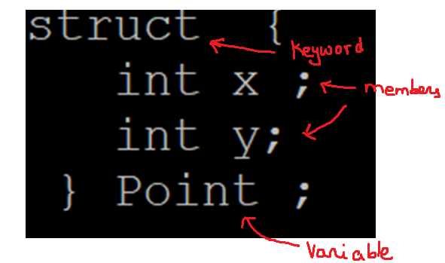
Declare structure and a variable without Tag name
In this sample structure definition, there is no tag name. Not recommended.

Slide 10
Defining Variables of Structure Types
Structure definitions do not reserve any space in memory; rather, each definition creates a new data type that’s used to define variables.
Structure variables are defined like variables of other types.
The definition
struct _test v1, v2, *s1, *s2, v3[5];
declares v1 and v2 to be variables of type struct _test , declares v3 be an array with 5 elements of type struct _test and declares s1 and s2 to be pointers to struct _test.

Slide 11
Structure Definitions (Cont.)
Variables of a given structure type may also be declared by placing a comma-separated list of the variable names between the closing brace of the structure definition and the semicolon that ends the structure definition.
For example, the preceding definition could have been incorporated into the struct _test definition as follows:
struct _test {
unsigned int m1 ;
unsigned char m2 ;
unsigned short m3 ;
unsigned char m4;
} v1, v2, *s1, *s2, v3[5] ;

Slide 12
Operations That Can Be Performed on Structures
The only valid operations that may be performed on structures are:
assigning structure variables to structure variables of the same type,
taking the address (&) of a structure variable,
accessing the members of a structure variable and
using the sizeof operator to determine the size of a structure variable.

Slide 13
Operations That Can Be Performed on Structures (Cont.)
Structures may not be compared using operators == and !=, because structure members are not necessarily stored in consecutive bytes of memory.
Sometimes there are “holes” in a structure, because computers may store specific data types only on certain memory boundaries such as half-word, word or double-word boundaries.
A word is a standard memory unit used to store data in a computer—usually 2 bytes or 4 bytes.

Slide 14
Structure Definitions (Cont.)
Consider the following structure definition, in which sample1 and sample2 of type struct example are declared:
struct _test {
unsigned int m1 ; 4
unsigned char m2 ; 1
unsigned short m3 ; 2
unsigned char m4; 1
} v1 , v2;
In the above definition, one might think the total size of this structure is : sizeof(int)+sizeof(char)+sizeof(short)+ sizeof(char) = 4+1+2+1 = 8. But when print the sizeof (v1) , it would be 12.
This is because there would be memory gaps between member variables and/or padding with memory that is wasted after the last member definition

Slide 15
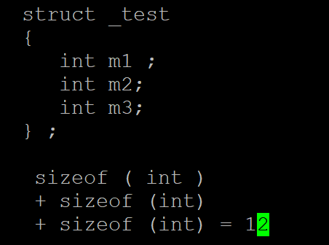
Quiz: Size of a structure
How much memory is allocated for a structure :
simply adding the size of individual members works if all members are same type.

Slide 16
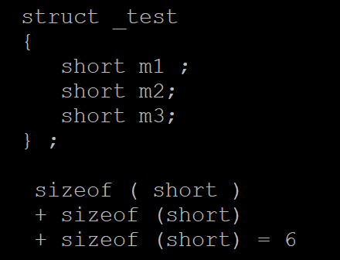
Quiz: what is the size of a structure
How much memory is allocated for a structure :
simply adding the size of individual members works if all members
are same type.

Slide 17
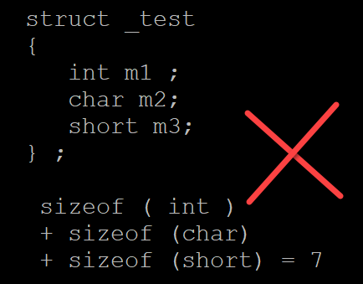
what if the members are different types ?
How much memory is allocated for a structure :
simply adding the size of individual members is would be wrong

Slide 18
what if the members are different types ?
How much memory is allocated for a structure :
simply adding the size of individual members is not enough. It would be incorrect if the structure contains members of different types
size of a structure is generally the multiple of the largest element of the members sufficient enough to hold the members.
What is largest mean ?
max ( char, char) = 1.
max ( short, char) = 2.
max ( int, short, char) = 4.
max ( double, int, short, char) = 8

Slide 19
Also, members are aligned in memory addresses that depends on their type.
for instance, a member of type int is placed in a memory address is the divisible by sizeof (int)=4.
a member of type short is placed in a memory address is the divisible by sizeof (short)=2.
a member of type double is placed in a memory address is the divisible by sizeof (double)=8.

Slide 20
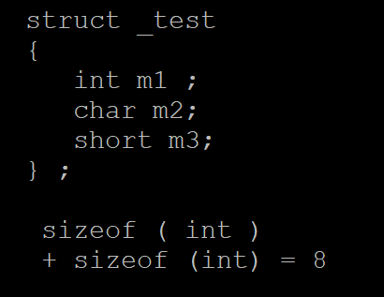
what if the members are different types ?
What is multiple mean ?
It means the size would be a multiple of the largest element sufficient enough to hold all members

Slide 21
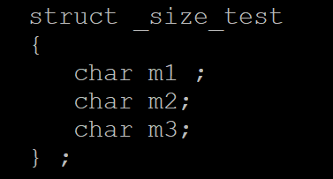
size is 3, multiple of max (char, char, char)

Slide 22
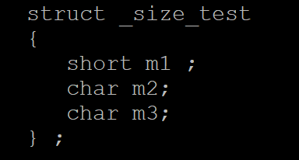
size is 4, multiple of max (short, char, char)
sizeof short is 2, add two chars , size is 4

Slide 23
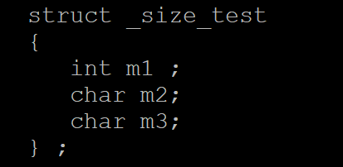
size is 8, multiple of max (int, char, char)
sizeof int is 4, add two chars , size is 8, not 6. Why, it is always a multiple of the largest element.
Due to which we have padding of two bytes at the end.

Slide 24
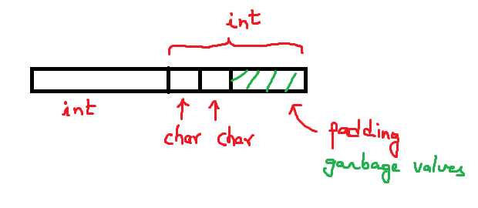
padding of two extra bytes, generally padded with garbage values.

Slide 25
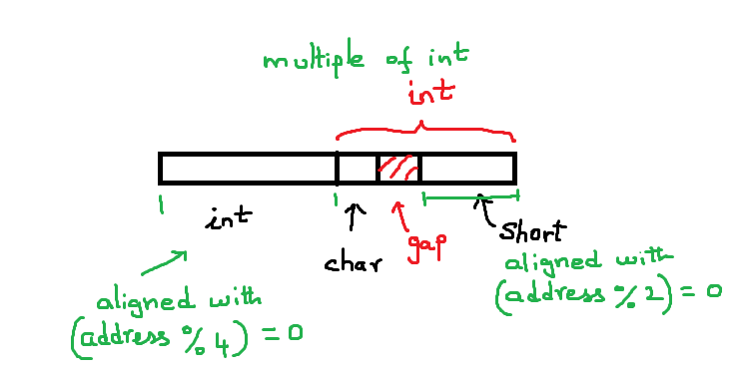
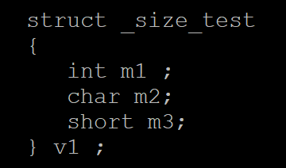
gap of one extra bytes, generally values contain garbage

Slide 26
How do you verify the gap

Slide 27
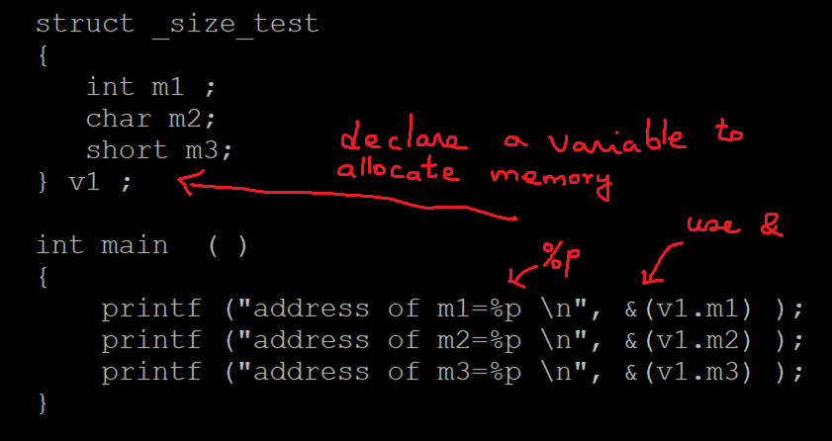

Slide 28
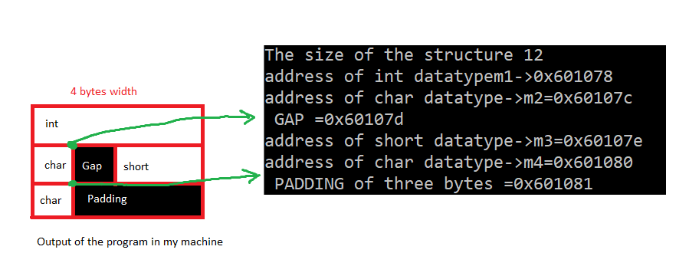
another example: Figure showing the gap and the padding.

Slide 29
Initializing Structures
Structures can be initialized using initializer lists as with arrays.
To initialize a structure, follow the variable name in the definition with an equals sign and a brace-enclosed, comma-separated list of initializers.
For example, the declaration
struct _test v1 = { 0x50, 65, 0x30, 97 } ;
creates variable test and initializes the members.

Slide 30
Initializing Structures (Cont.)
If there are fewer initializers in the list than members in the structure, the remaining members are automatically initialized to 0 (or NULL if the member is a pointer).
Structure variables defined outside a function definition (i.e., externally) are initialized to 0 or NULL if they’re not explicitly initialized in the external definition.
Structure variables may also be initialized in assignment statements by assigning a structure variable of the same type, or by assigning values to the individual members of the structure.

Slide 31
struct _test v7 = { 0x50, 65, 0x30, 97 } ; /* m1 is set to 0x50, m2='A', m3=0x30, m4='a' */
struct _test v8 = { 0x50, 65 } ; /* m1 is set to 0x50, m2='A', m3=0, m4=0 */
struct _test v9 = { 0 } ; /* all set to zero */
struct _test v10 = v7 ; /* okay to assign one structure to another of same type */
struct _test v11 [ 3 ] = { { 0x50, 'A', 0x30, 'a'}, { 0x60, 'B' }, { 0x70,'C'} }; /* initialize an array */
v1 = v10 ; /* is also okay */

Slide 32
Accessing Structure Members
Two operators are used to access members of structures: the structure member operator (.)—also called the dot operator—and the structure pointer operator (->)—also called the arrow operator.
The structure member operator accesses a structure member via the structure variable name.
For example, to print the m1 and m2, , we write
printf("%d %d", v1.m1, v1.m2);

Slide 33
Accessing Structure Members (Cont.)
The structure pointer operator—consisting of a minus (-) sign and a greater than (>) sign with no intervening spaces—accesses a structure member via a pointer to the structure.
Assume that the pointer *s1 has been declared as type of struct _test and that the address of structure v1 has been assigned to s1.
s1 = &v1;
To print member m1 and m2 , we would do in two ways
printf("s1.m1=%d s1.m2=%d\n", (*s1).m1, (*s1).m2);
printf("s1->m1%d s1->m2=%d\n", s1->m1, s1->m2);

Slide 34
Accessing Structure Members (Cont.)
The expression s1->m1 is equivalent to (*s1).m1, which dereferences the pointer and accesses the member suit using the structure member operator.
The parentheses are needed here because the structure member operator (.) has a higher precedence than the pointer dereferencing operator (*).
The structure pointer operator and structure member operator, along with parentheses (for calling functions) and brackets ([]) used for array subscripting, have the highest operator precedence and associate from left to right.

Slide 35
Using Structures with Functions
Structures may be passed to functions by passing individual structure members, by passing an entire structure or by passing a pointer to a structure.
When structures or individual structure members are passed to a function, they’re passed by value.
Therefore, the members of a caller’s structure cannot be modified by the called function.
To pass a structure by reference, pass the address of the structure variable.

Slide 36
Using Structures with Functions (Cont.)
Arrays of structures—like all other arrays—are automatically passed by reference.
To pass an array by value, create a structure with the array as a member.
Structures are passed by value, so the array is passed by value.

Slide 37
pass structures by value to functions
void print_structure ( struct _test aStr )
{
printf ( "m1=%x m2=%c\n", aStr.m1, aStr.m2 ) ;
aStr.m1 = 20;
}
main ( )
{
print_structure ( v1 ) ;
}

Slide 38
pass structures by reference to functions
void update_structure ( struct _test *strPtr )
{
(strPtr->m1)++; /* Alternatively (*strPtr).m1++ */
strPtr->m2 = 'B';
print_structure ( *strPtr ) ;
}
main ( )
{
update_structure ( &v1 ) ;
struct _test *s1 = &v1
/* Alternatively using pointer, updatestructure ( s1 ) ; */
}

Slide 39
Passing an array of structure
void print_array_of_structures ( struct _test data[ ], int noCells )
{
int i = 0;
for ( i = 0 ; i < noCells ; i++ )
printf ( "data[%d] m1=%x m2=%c \n", i, data[i].m1 , data[i].m2);
/* alternatively using pointers
printf ( "data[%d] m1=%x m2=%c \n", i, (data+i)->m1 , (data+i)->m2);
*/
}
struct _test v11[3] ;
print_array_of_structures ( v11 , sizeof ( v11) / sizeof( v11[0]) );

Slide 40
typedef
The keyword typedef provides a mechanism for creating synonyms (or aliases) for previously defined data types.
Names for structure types are often defined with typedef to create shorter type names.
For example, the statement
typedef struct _test Test_T;
defines the new type name Test_Tas a synonym for type struct _test .
C programmers often use typedef to define a structure type, so a structure tag is not required.

Slide 41
typedef (Cont.)
For example, the following definition
typedef struct _test Test_T;
alternatively
typedef struct _test {
unsigned int m1 ;
unsigned char m2 ;
unsigned short m3 ;
unsigned char m4;
} Test_T;
creates the structure type Test_t without the need for a separate typedef statement.

Slide 42
TEST_T v12 ;
v12.m1 = 0x60;
v12.m2 = 'C' ;
/* Alternatively we could have done , TEST v12 = { 0x60, 'C' } ; */
print_structure_T ( v12 ) ;
update_structure_T ( &v12 ) ;
void print_structure_T ( TEST_T aStr )
{
printf ( "m1=%x m2=%c\n", aStr.m1, aStr.m2);
}
void update_structure_T ( TEST_T *strPtr )
{
(strPtr->m1)++; /* Alternatively (*strPtr).m1++ */
strPtr->m2 = 'B';
print_structure ( *strPtr ) ;
}

Slide 43
typedef (Cont.)
Test_T can now be used to declare variables of type struct _test.
The declaration
Test_T V3[3];
declares an array of 3 Test_T structures (i.e., variables of type struct _test ).
Creating a new name with typedef does not create a new type; typedef simply creates a new type name, which may be used as an alias for an existing type name.

Slide 44
Nested Structures: Structures within a structure
within a structure, we could define another structure of another type as a member. For instance,
struct _test1 {
char ch;
} ;
struct _test2 {
int x;
struct _test1 y; // structure within a structure
}

Slide 45
Lab Example: Structure declaration.
struct _file_names_and_sizes {
char name[128];
unsigned int size;
} ;

Slide 46
Structure initialization during declaration
struct _file_names_and_sizes list [ 5 ] = {
{ "quickSort.c", 1002 } ,
{ "bubbleSort.c", 987 } ,
{ "insertionSort.c", 1892 } ,
{ "selectionSort.c", 799 } ,
{ "mergeSort.c", 1332 }
};

Slide 47
Alternate way of structure initialization after declaration
struct _file_names_and_sizes list [ 5 ] ;
#include <string.h>
strcpy ( list[0].name,"quickSort.c");
list[0].size = 1002;
strcpy ( list[1].name," bubbleSort.c ");
list[1].size = 987 ;
strcpy ( list[2].name," insertionSort.c ");
list[2].size = 1892 ;
strcpy ( list[3].name," selectionSort.c ");
list[3].size = 799 ;
strcpy ( list[4].name," mergeSort.c ");
list[4].size = 1332 ;

Slide 48
print the structure – Method 1.
int main ( )
{
int i , size = sizeof ( list) / sizeof ( list[0] ) ;
for ( i = 0 ; i < size; i++ )
printf ( "%s %d \n", list[i].name, list[i].size);
}

Slide 49
Print using a pointer – Method 2
int main ( )
{
int i , size = sizeof ( list) / sizeof ( list[0] ) ;
struct _file_names_and_sizes *ptr;
ptr = &list[0];
for ( i = 0 ; i < size; i++, ptr++ )
printf ( "%s %d \n", ptr->name, ptr->size);
}

Slide 50
Pass the structure by reference - Method 3
print (struct _file_names_and_sizes *p )
{
for ( i = 0 ; i < size; i++, p++ )
printf ( "%s %d \n", p->name, p->size);
}
int main ( )
{
int size = sizeof ( list) / sizeof ( list[0] ) ;
struct _file_names_and_sizes *ptr;
ptr = &list[0];
print ( ptr );
}

Slide 51
Pass the structure by reference - Method 4
print (const struct _file_names_and_sizes *p )
{
for ( i = 0 ; i < size; i++,)
printf ( "%s %d \n", (p+i)->name, (p+i)->size);
}
int main ( )
{
int size = sizeof ( list) / sizeof ( list[0] ) ;
struct _file_names_and_sizes *ptr;
ptr = &list[0];
print ( ptr );
}

Slide 52
Homework:
create a structure named _parent_child_process
create three fields: processID, parentProcessID, cmdName
processID and parentProcessID should be type unsigned int
cmdName should be string of 32 characters
create an array of structure named "list" with 5 cells
initialize them with { 188921, 1, "postgres" },
{1665393, 1665392, "bash"} , {1665399, 1665392, "bash"} ,
{1665392, 1, "sshd" }, {188967, 1, "apache2" }
print the list displaying the cmdName, parentProcessID , processID

